Slide 1

Study the Coulomb breakup of ⁷Li into alpha+t:
Potential model for t(α,γ)⁷Li
S-factor calculations
Eki González Flamarique

Slide 2
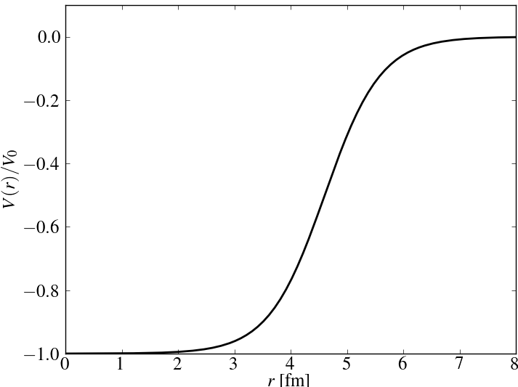
Two cluster model ⁷Li with Woods-Saxon potential
⁷Li
Model strong force by Woods-Saxon potential
α
r
t
E ψ(r) = -ħ²/2m ∇²ψ(r) + V(r)ψ(r)
Spherical symmetry → |n l j m〉
Imposing boundary conditions → partial waves
Transitions from continuum to bound states

Slide 3

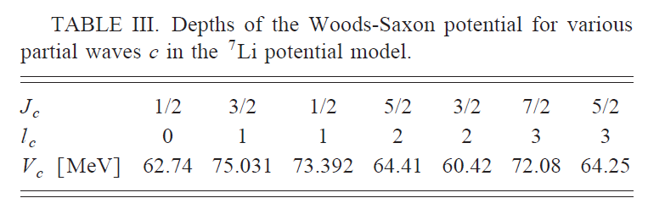
Starting point: Literature review
Find experimental measurements of cross-section
Search for a potential model to describe ⁷Li as α+t
Reproduce papers results by Fortran codes.
Tokimoto

Slide 4
Name | Year | Energy range, Ecm | Method | Target | Beam intensity
Holmgren | 1958 | 450 < E < 1350 keV | Direct | 3H and 3He gases | 0.2 or 0.3 ua alpha
Griffiths | 1961 | 0.35 < E < 1.83 MeV | Direct | Tritium targets absorbed in thin evaporated layers of Zr on Pt backings. | ¿?
Burzynski | 1987 | 280 < E < 900 keV | Direct | T-Ti targets | up to 15 uA alpha
Schröder | 1987 | 50 < E < 480 keV | Direct | Ti3H about 20 mu-g/cm2 thick a Cu backing | alpha particle currents of 2-13 uA
Utsunomiya | 1990 | 80 < E < 980 keV | Indirect by breakup | 27Al - 208Pb | 42 - 63 MeV – 7Li
Brune | 1994 | 50 < E < 1200 keV | Direct | Ti-3H | 20 nA—30 uA alpha particles
Tokimoto | 2001 | 100 < E < 500 keV | Coulomb breakup | 27Al - 197Au | 42 MeV– 7Li 30–300 nA
Bystritsky | 2016 | 15.7 keV = E | Direct | titanium tritide TiT | ~ 5 × 10^14 4He+ ions per pulse

Slide 5
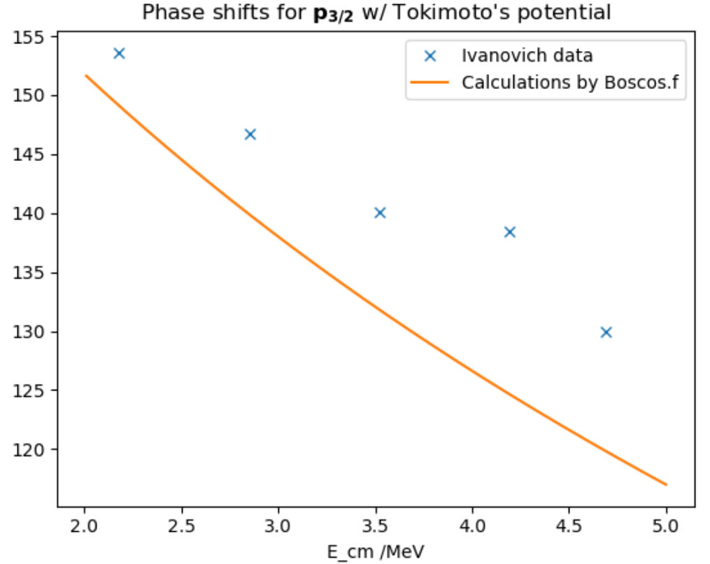
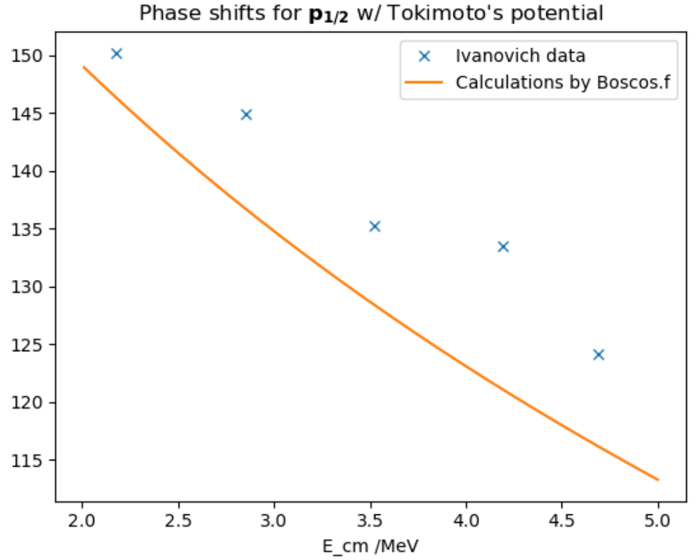
Try to reproduce Tokimoto’s results for bound states
— 2.50
2.467 — — — —
Varying mass and radius parameters, phase-shifts and binding energy results are significantly off → REFIT IS NEEDED.
— 2.40
2.366 —
— 2.30
— 2.20
2.135 —
— 2.10
E /MeV

Slide 6
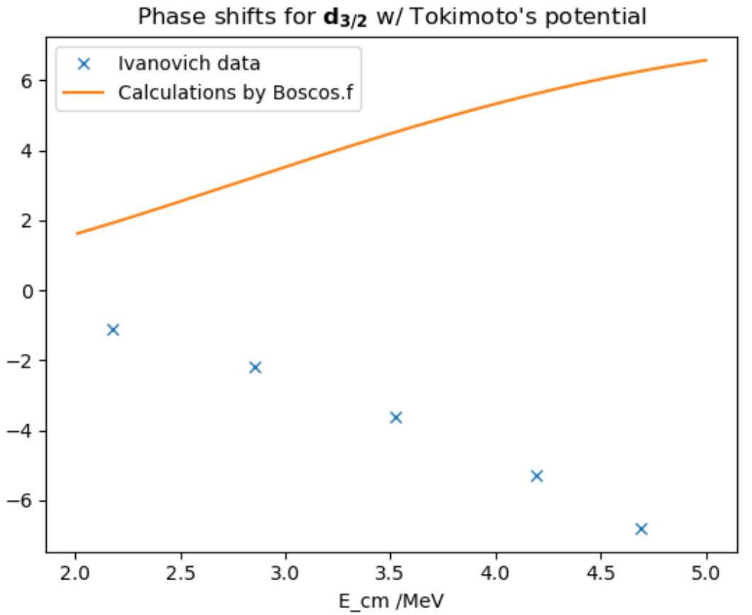
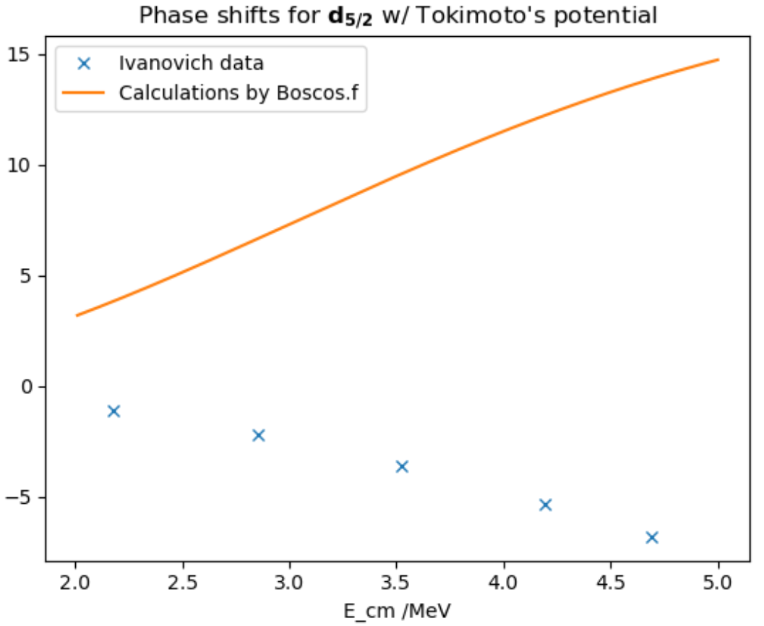
Try to reproduce Tokimoto’s results for continuum states
For d-waves, results phase-shifts results are completely off.
→ REFIT IS NEEDED.

Slide 7
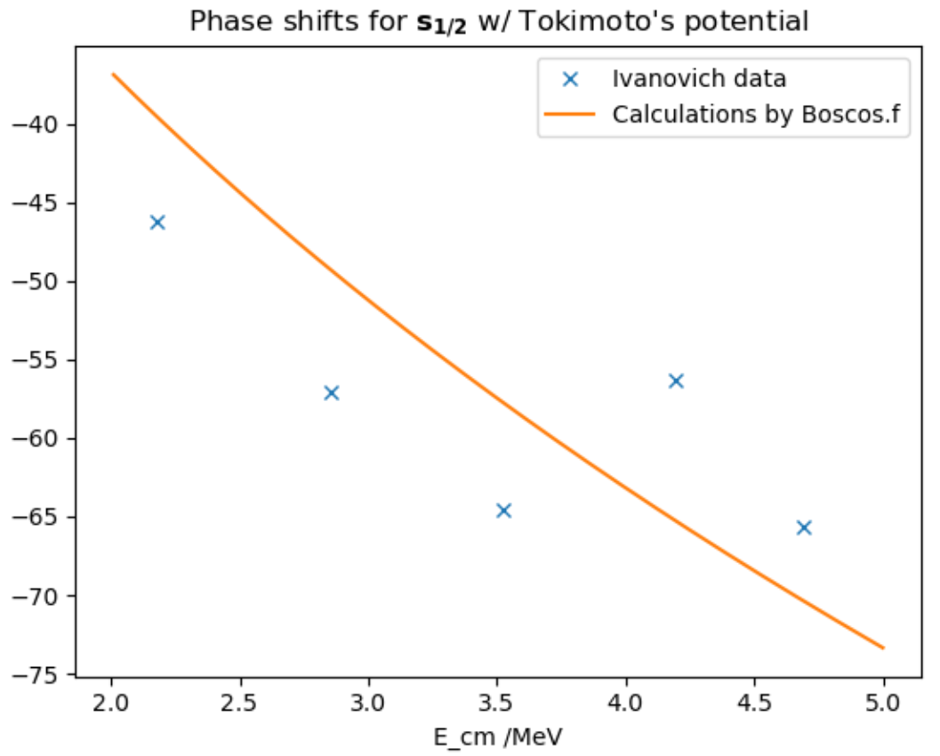
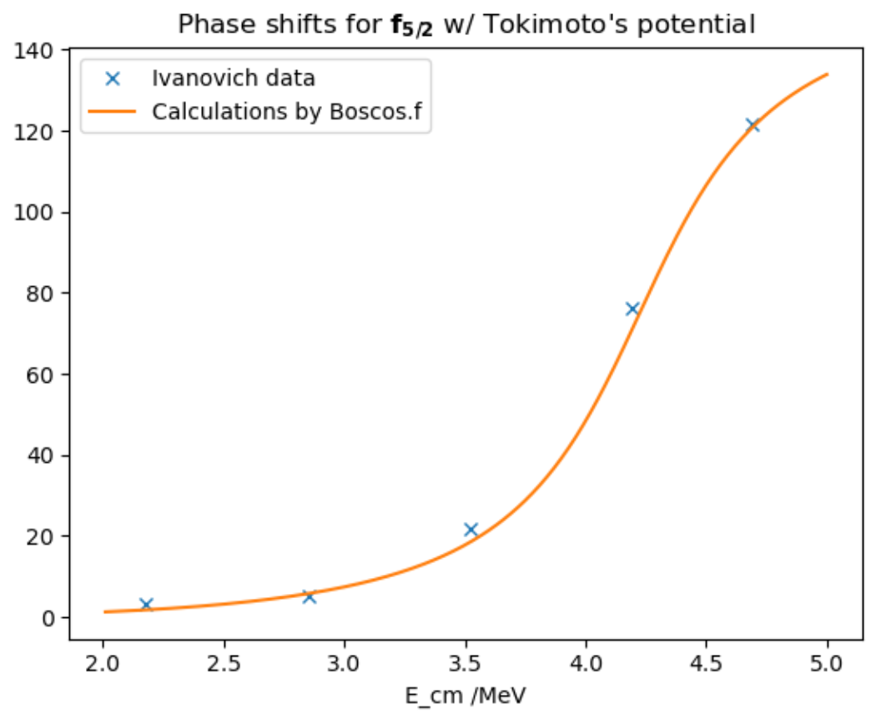
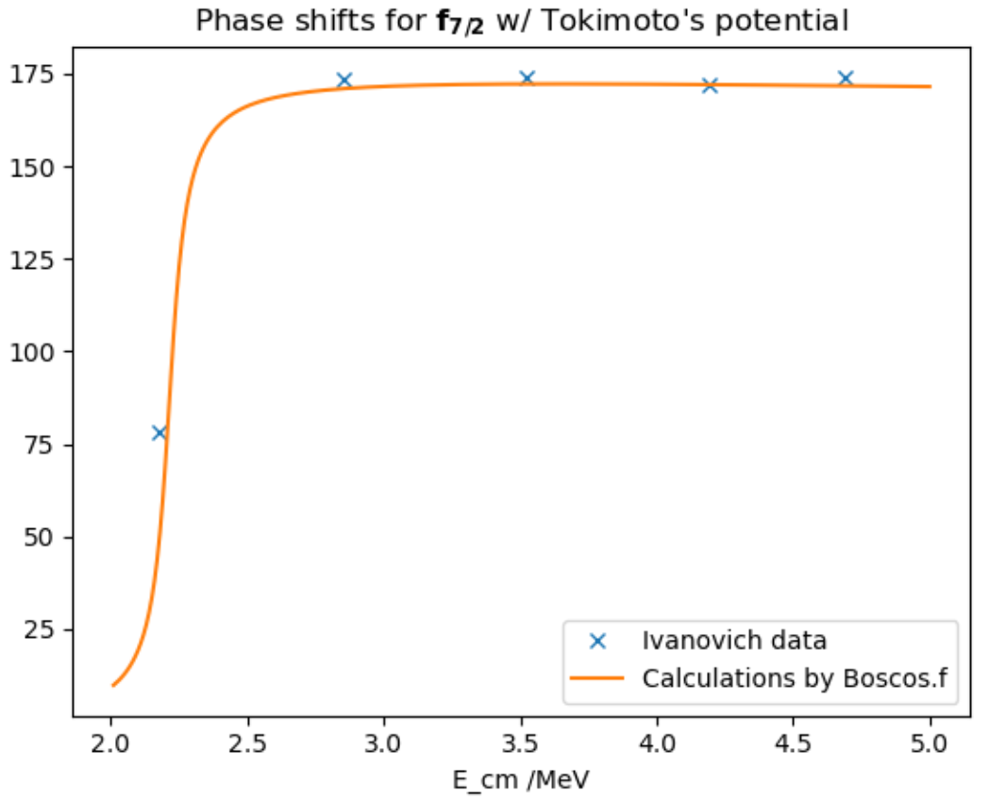
Try to reproduce Tokimoto’s results for continuum states
For s-wave and f-waves, results phase-shifts results are good.

Slide 8
Correct by refitting Tokimoto’s model
For s-wave and f-waves we will use Tokimoto’s parameters.
Refit p-waves’ parameters to experimental binding energy.
Refit d-waves’ parameters to phase-shift data.
Adjust method are usual bisection and secant.

Slide 9
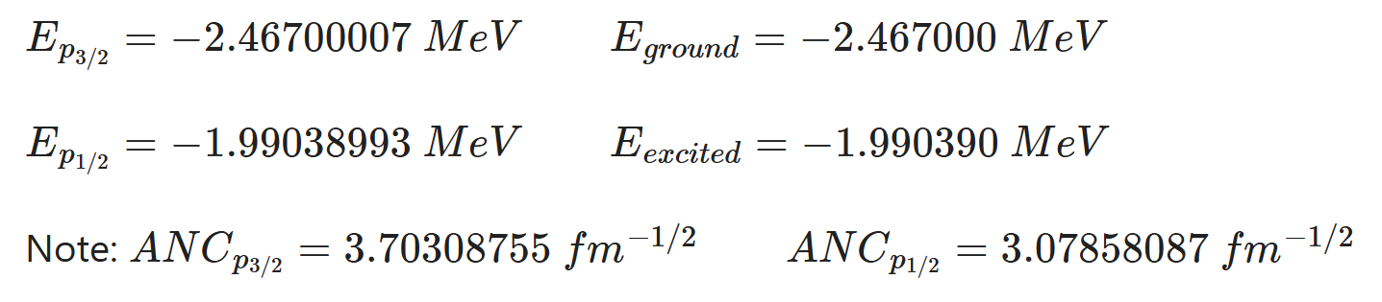
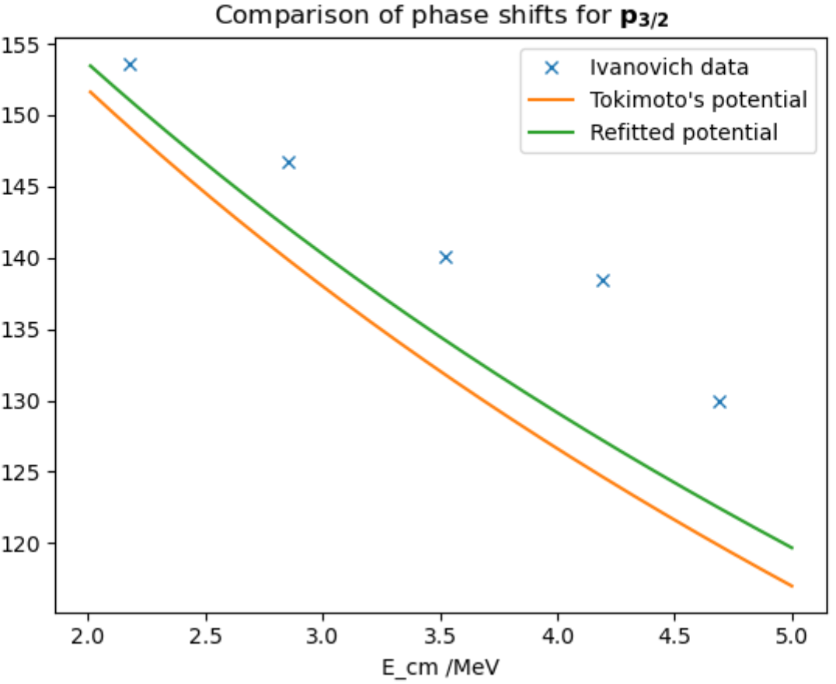
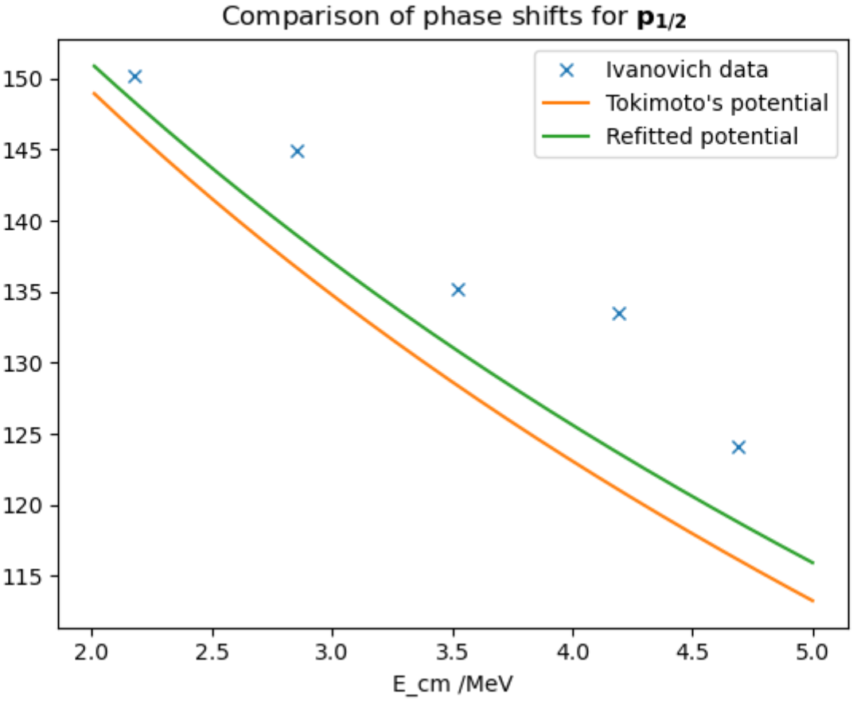
Correct by refitting Tokimoto’s model: p-waves

Slide 10
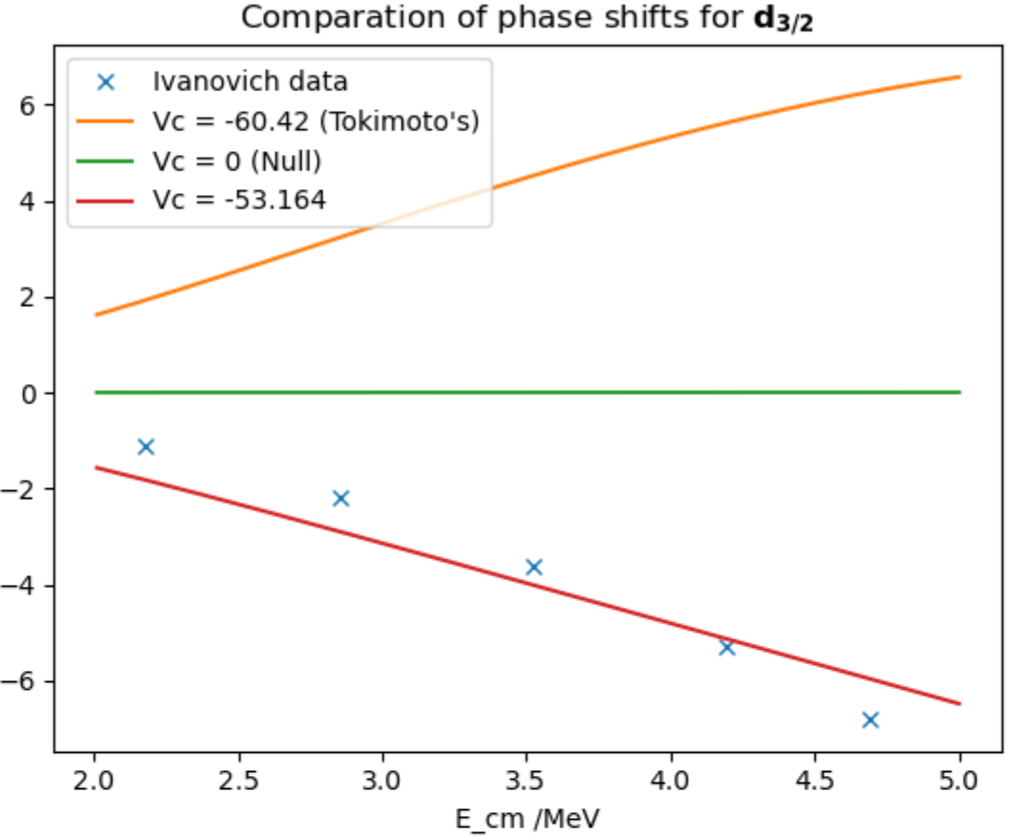
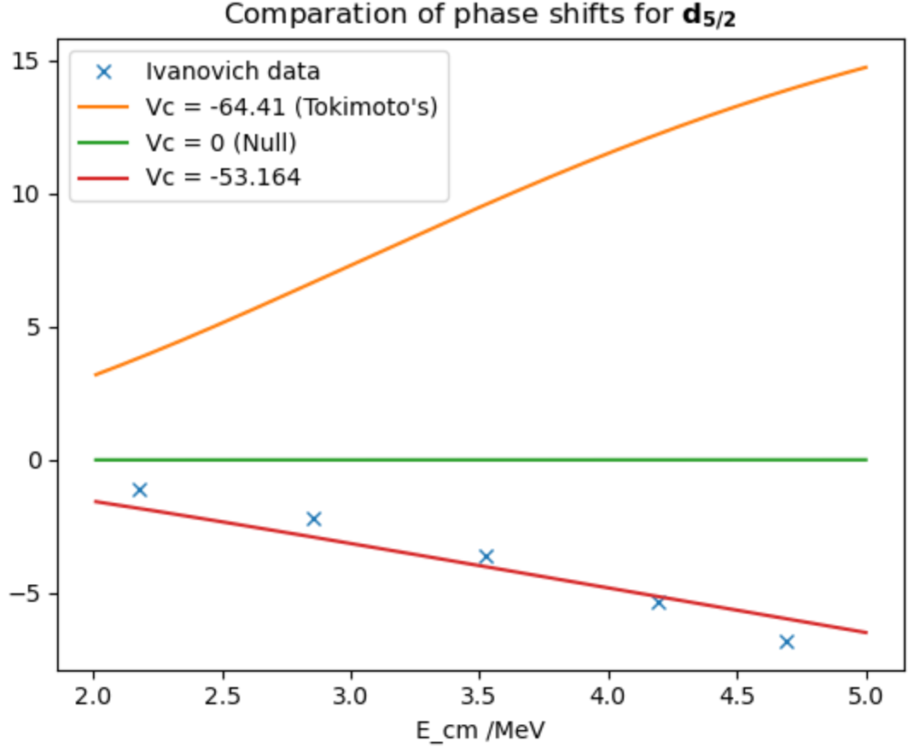
Correct by refitting Tokimoto’s model: d-waves

Slide 11
Correct by refitting Tokimoto’s model: conclusion
For s-wave and f-waves we will use Tokimoto’s parameters.
d-waves’ parameters refitted to phase-shift data.
p-waves’ parameters refitted to binding energy data:
→ Phase-shift is quite offsetted.
→ ANC doesn’t agree completely with measures. →
Knowing the true ANC,
we can scale cross-section
vs.
[ 2006, S.B. Igamov, R. Yarmukhamedov ]

Slide 12
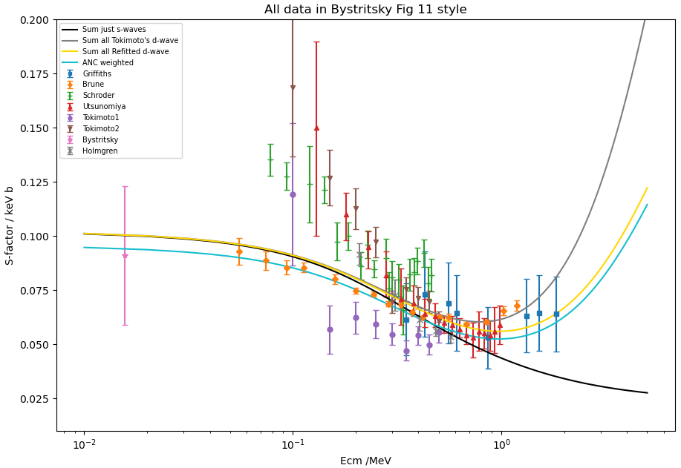

Slide 13
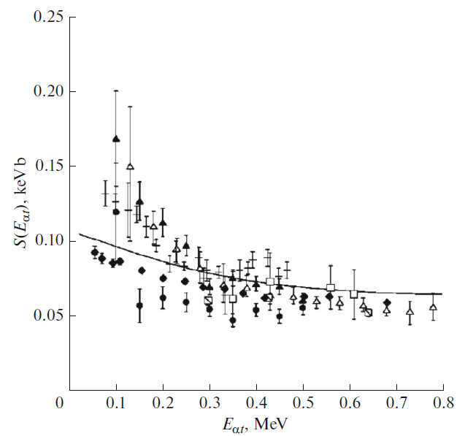
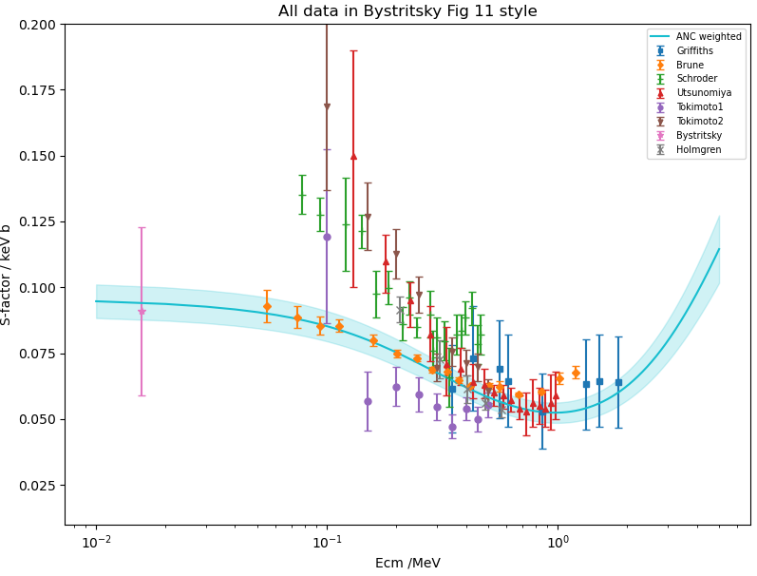
Final results and comparison
Fig. 1.
→ Solid line for Tokimoto’s results
[ 2016, V. M. Bystritsky, * ]

Slide 14
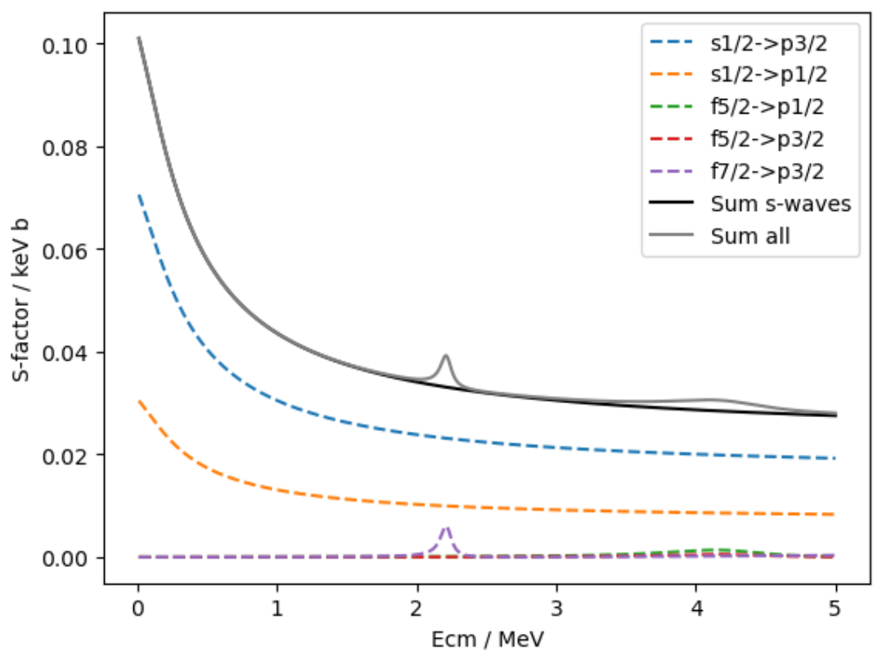
Significance of E2 transitions from f-waves
Using Tokimoto’s parameters
Conclusions:
Contributions no significant at all
Resonances quite well reproduced

Slide 15
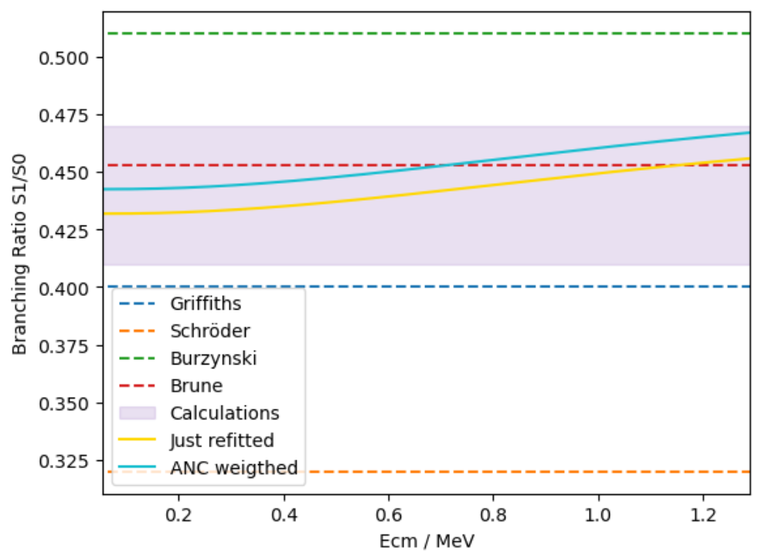
Investigate branching ratio, Igamov & Brune
In Brune’s paper there are several estimations of R = S1/S0
Griffiths R ~ 0.4
Schröder R = 0.32+-0.01
Burzynski R ~ 0.51
Calculations R in (0.41, 0.47)
T. Kajino, Nucl. Phys. A460, 559 (1986).
T. Altmeyer, E. Kolbe, T. Warmann, K. Langanke, and H. J. Assenbaum, Z. Phys. A 330, 277 (1988).
P. Mohr, H. Abele, R. Zwiebel, G. Staudt, H. Krauss, H. Oberhummer, A. Denker, J. W. Hammer, an G. Wolf, Phys. Rev. C 48, 1420 (1993)
· T. Kajino, G. J. Mathews, and K. Ikeda, Phys. Rev. C 40, 525 (1989)
Brune = 0.453

Slide 16
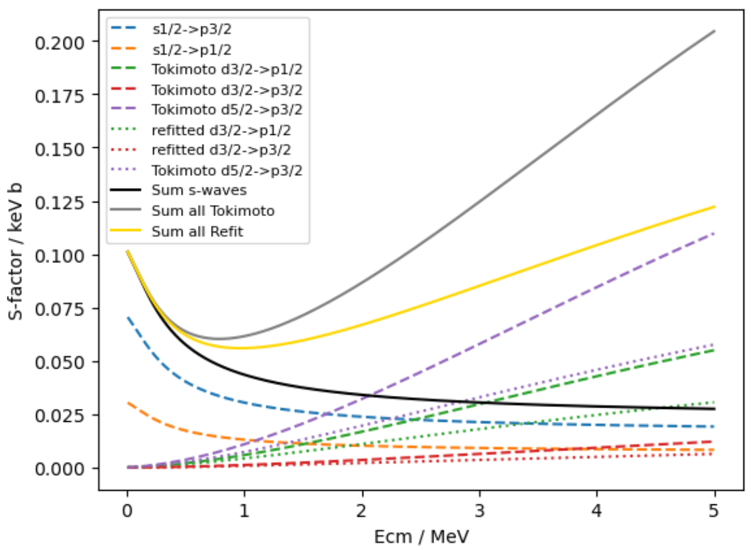
Contributions from d-waves
Refitted potential have smaller contributions for increasing energies than Tokimoto’s.
Low energy tails stay pretty similar.

